Slide 1

Dr.G.Padmavathi Assistant Professor CRRAO AIMSCS
Overview of Supervised & Un-Supervised Learning

Slide 2
Introduction to Machine learning
Machine learning algorithms are trained with training data.
When new data comes in, they can make predictions and decisions accurately based on past data.

Slide 3
Example
If we ask Siri to do something
finally, Siri tells you the answer
Siri
a powerful speech recognition converts the audio into its corresponding textual form
sent to the Apple servers for further processing
where language processing algorithms are run to understand the user's intent.

Slide 4
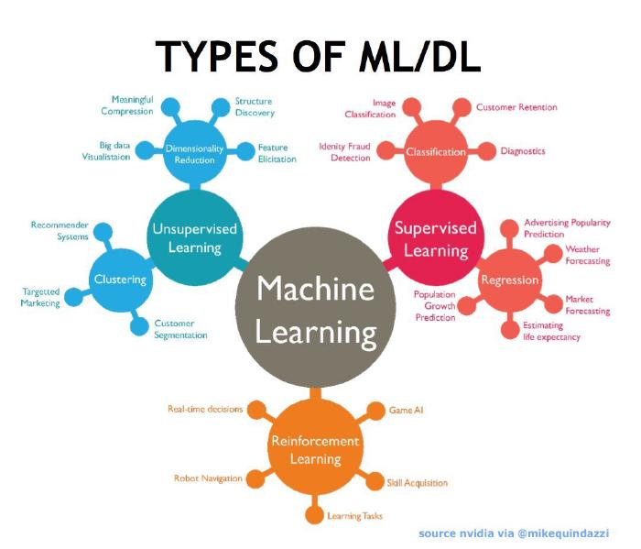
https://livecodestream.dev/post/2020-06-02-7-steps-of-machine-learning/

Slide 5
Types of machine learning
Supervised Learning
Unsupervised Learning
Reinforcement Learning

Slide 6
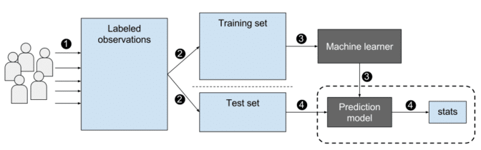
Supervised Learning
In Supervised Learning, the machine learns under supervision.
It contains a model that is able to predict with the help of a labeled dataset. A labeled dataset is one where you already know the target answer.

Slide 7
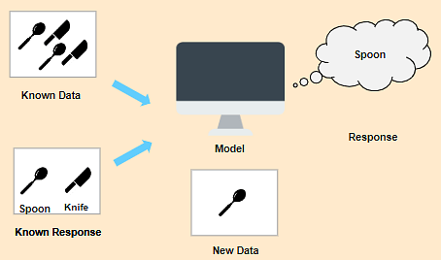
Example of Supervised Learning
Known data is fed to the machine, which analyzes and learns the association of these images based on its features such as shape, size, sharpness, etc.
When a new image is fed to the machine without any label, the machine is able to predict accurately that it is a spoon with the help of the past data.

Slide 8
Classification of Data
Types of ML Classification Algorithms:
Logistic Regression
K-Nearest Neighbours
Support Vector Machines
Kernel SVM
Naïve Bayes
Decision Tree Classification
Random Forest Classification

Slide 9
Types of Regression Algorithm
Simple Linear Regression
Multiple Linear Regression
Polynomial Regression
Support Vector Regression
Decision Tree Regression
Random Forest Regression

Slide 10
Regression Algorithm | Classification Algorithm
In Regression, the output variable must be of continuous nature or real value. | In Classification, the output variable must be a discrete value.
The task of the regression algorithm is to map the input value (x) with the continuous output variable(y). | The task of the classification algorithm is to map the input value(x) with the discrete output variable(y).
Regression Algorithms are used with continuous data. | Classification Algorithms are used with discrete data.
In Regression, we try to find the best fit line, which can predict the output more accurately. | In Classification, we try to find the decision boundary, which can divide the dataset into different classes.
Regression algorithms can be used to solve the regression problems such as Weather Prediction, House price prediction, etc. | Classification Algorithms can be used to solve classification problems such as Identification of spam emails, Speech Recognition, Identification of cancer cells, etc.
The regression Algorithm can be further divided into Linear and Non-linear Regression. | The Classification algorithms can be divided into Binary Classifier and Multi-class Classifier.

Slide 11
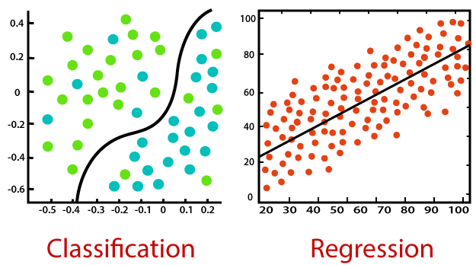
Regression and Classification

Slide 12
Classifier comparison
A comparison of a several classifiers in scikit-learn on synthetic datasets.
The point of this example is to illustrate the nature of decision boundaries of different classifiers.
The plots show training points in solid colors and testing points semi-transparent. The lower right shows the classification accuracy on the test set.

Slide 13
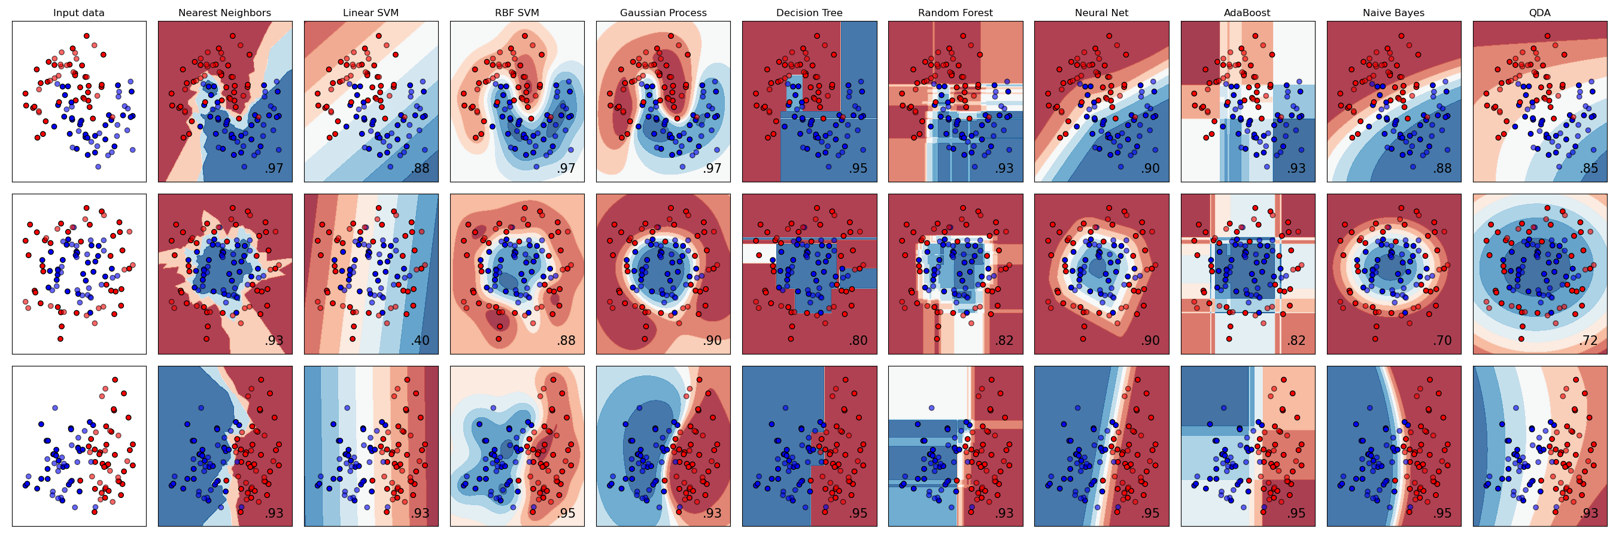
The plots show training points in solid colors and testing points semi-transparent. The lower right shows the classification accuracy on the test set.

Slide 14
Regression Algorithm | Classification Algorithm
In Regression, the output variable must be of continuous nature or real value. | In Classification, the output variable must be a discrete value.
The task of the regression algorithm is to map the input value (x) with the continuous output variable(y). | The task of the classification algorithm is to map the input value(x) with the discrete output variable(y).
Regression Algorithms are used with continuous data. | Classification Algorithms are used with discrete data.
In Regression, we try to find the best fit line, which can predict the output more accurately. | In Classification, we try to find the decision boundary, which can divide the dataset into different classes.
Regression algorithms can be used to solve the regression problems such as Weather Prediction, House price prediction, etc. | Classification Algorithms can be used to solve classification problems such as Identification of spam emails, Speech Recognition, Identification of cancer cells, etc.
The regression Algorithm can be further divided into Linear and Non-linear Regression. | The Classification algorithms can be divided into Binary Classifier and Multi-class Classifier.

Slide 15
Unsupervised Learning
Unsupervised machine learning finds all kind of unknown patterns in data.
Unsupervised methods help you to find features which can be useful for categorization.
It is taken place in real time, so all the input data to be analyzed and labeled in the presence of learners.
It is easier to get unlabeled data from a computer than labeled data, which needs manual intervention.
where you are not taught but you learn from the data (based on features/patterns/associations) - comes under Unsupervised Learning.

Slide 16
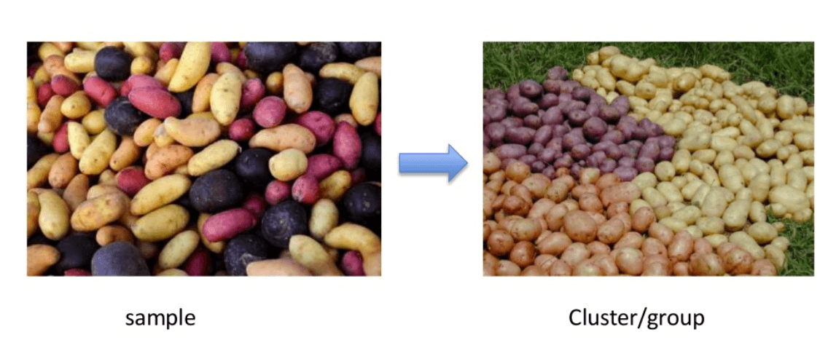
Clustering-Unsupervised Learning

Slide 17
There are different types of clustering we can utilize:
Exclusive (partitioning)
In this clustering method, Data are grouped in such a way that one data can belong to one cluster only.
Example: K-means
Agglomerative
In this clustering technique, every data is a cluster. The iterative unions between the two nearest clusters reduce the number of clusters.
Example: Hierarchical clustering

Slide 18
Overlapping
In this technique, fuzzy sets is used to cluster data. Each point may belong to two or more clusters with separate degrees of membership.
Here, data will be associated with an appropriate membership value. Example: Fuzzy C-Means
Probabilistic
This technique uses probability distribution to create the clusters
Example: Following keywords can be clustered into two categories “shoe” and “glove” or “man” and “women.”
“man’s shoe.”
“women’s shoe.”
“women’s glove.”
“man’s glove.”

Slide 19
Clustering Types
Hierarchical clustering
K-means clustering
K-NN (k nearest neighbors)
Principal Component Analysis
Singular Value Decomposition
Independent Component Analysis
A Comprehensive Survey of Clustering Algorithms Xu, D. & Tian, Y. Ann. Data. Sci. (2015) 2: 165.
https://developers.google.com/machine-learning/clustering/overview

Slide 20
Association-Unsupervised Learning
Association rules allow us to establish associations amongst data objects inside large databases. This unsupervised technique is about discovering interesting relationships between variables in large databases.
Some examples
people that buy a new home most likely to buy new furniture.
Groups of shopper based on their browsing and purchasing histories
Movie group by the rating given by movies viewers
A subgroup of cancer patients grouped by their gene expression measurements

Slide 21
Applications of Unsupervised Machine Learning
Clustering automatically split the dataset into groups base on their similarities
Anomaly detection can discover unusual data points in our dataset. It is useful for finding fraudulent transactions.
Association mining identifies sets of items which often occur together in our dataset
Latent variable models are widely used for data preprocessing. Like reducing the number of features in a dataset or decomposing the dataset into multiple components
https://www.kaggle.com/farhanmd29/unsupervised-learning

Slide 22
Supervised vs. Unsupervised Machine Learning
Parameters | Supervised machine learning technique | Unsupervised machine learning technique
Input Data | Algorithms are trained using labeled data. | Algorithms are used against data which is not labelled
Computational Complexity | Supervised learning is a simpler method. | Unsupervised learning is computationally complex
Accuracy | Highly accurate and trustworthy method. | Less accurate and trustworthy method.

Slide 23
Reinforcement learning
Reinforcement Learning(RL) is a type of machine learning technique that enables an agent to learn in an interactive environment by trial and error using feedback from its own actions and experiences.

Slide 24
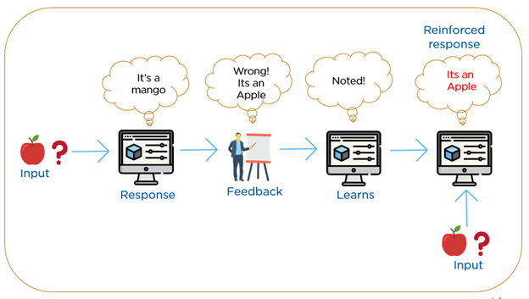
Reinforcement learning
https://towardsdatascience.com/an-introduction-to-reinforcement-learning-1e7825c60bbe

Slide 25
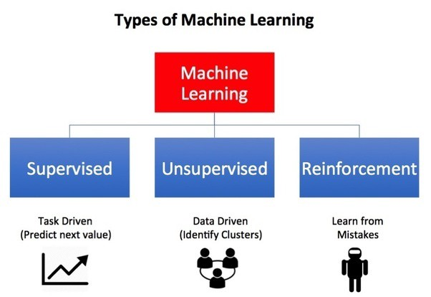
https://towardsdatascience.com/reinforcement-learning-101-e24b50e1d292

Slide 26
Thank you

Slide 27
Refere
https://blogs.nvidia.com/blog/2018/08/02/supervised-unsupervised-learning/#:~:text=In%20a%20supervised%20learning%20model,and%20patterns%20on%20its%20own.
https://www.javatpoint.com/regression-vs-classification-in-machine-learning
https://towardsdatascience.com/introduction-to-regression-analysis-9151d8ac14b3#:~:text=Regression%20and%20classification%20are%20both,their%20models%20and%20make%20predictions.&text=While%20in%20regression%2C%20the%20output,output%20is%20categorical%20or%20discrete.
https://www.guru99.com/unsupervised-machine-learning.html

